Slide 1
Financial table <PL>
Prompt output_PL
Keyword
Result search
DuckDuckgo Search API
Snippet
Title
Link source
Snippet
Title
Link source
Snippet
Title
Link source
…
2 Prompt analytics
Add
Prompt summary
Prompt
Get keyword of finance
Snippet
Title
Link source
Prompt check title
<relate to finance?>
Key1
Key2
…
Snippet
Title
Link source
Answer
No relate
Title
Link source
…
Bỏ

Slide 2
Financial table <PL>
Prompt output_PL
Keyword
Result search
Google Search API
Snippet
Title
Link source
Snippet
Title
Link source
Snippet
Title
Link source
…
2 Prompt analytics
Add
Update
All Snippets
Title
Link source
Prompt
Get keyword of finance
Snippet
Title
Link source
Prompt check title
<relate to finance?>
Snippet
Title
Link source
Context
Crawl data from link
Key1
Key2
…
…
No relate
Prompt
Explain
Final output
Explain
Title/ Link source
Context

Slide 3
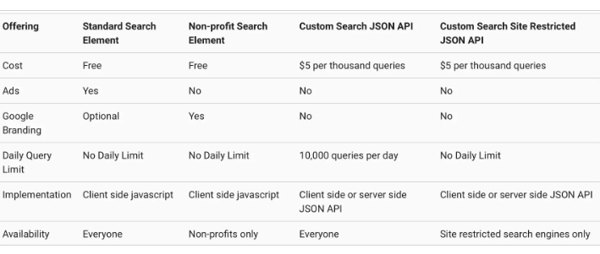
Use Google API Search
100 yêu cầu đầu tiên mỗi ngày: Miễn phí
Sau 100 yêu cầu miễn phí: 5 USD cho mỗi 1,000 yêu cầu bổ sung
12*5=60 /1000 *5 = 0.3$ / 1 lần chạy

